Slide 1
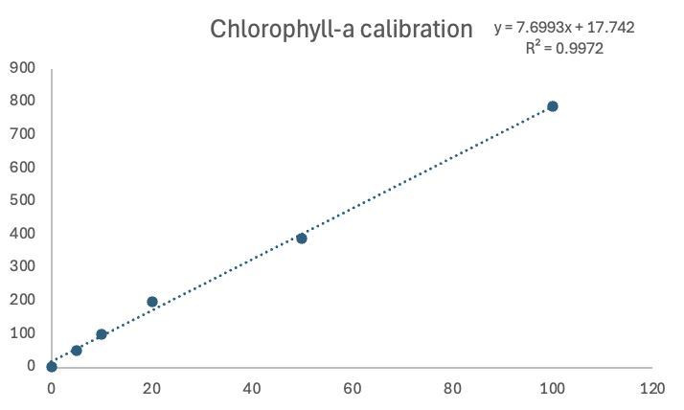
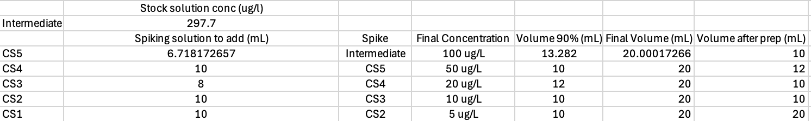
Chlorophyll-a calibration curve
Dilutions made from a stock solution measured at 297.7 ug/L
Completed serial dilution from 100 to 5 ug/L in 90% acetone
Vortexed stocks and standards before spiking
Concentration (ug/L) | Counts
100 | 788.625
50 | 389.1875
20 | 199.75
10 | 99.4375
5 | 50.75
0 | 3.0625

Slide 2
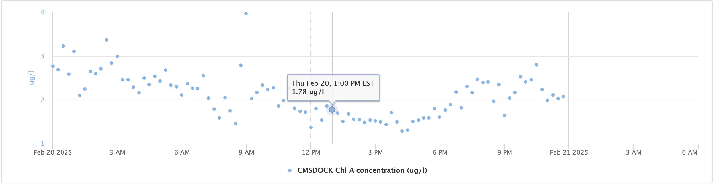
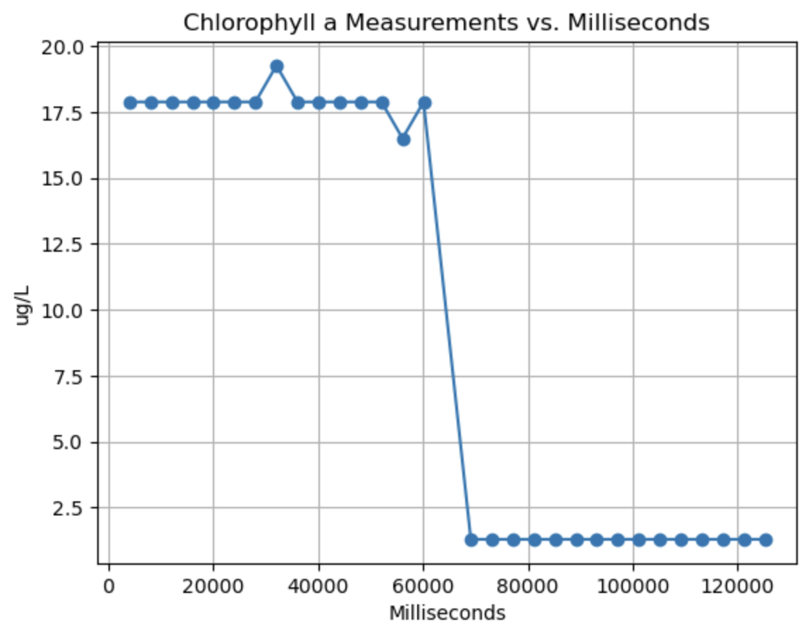
Field validation test
Sampling location close to CORMP EXO2
1.78 ug/L measurement from CORMP
Measurement taken on the surface in an amber bottle
CORMP measurements deeper
17.89 ug/L average on OF
Factor of 10 difference, calculation error or sensor issue?

Slide 3
Potential causes of discrepancy
Calculations
Spreadsheet for trichromatic chlorophyll method may have calculation mistake
Problem with calibration curve calculations
Problem with python script
Environmental factors
Acetone vs seawater
Photochemical quenching in seawater
EXO2 in a slightly different place at a different depth (slightly)
Sensor sensitivity issue

Slide 4
Solutions
Check all calculations again and have Phil double check them
Calibrate Dr. Loh’s Horiba and test standards on there to determine if it agrees with the spectrophotometer or the OF
Use Van Dorn sampler to sample in the same place and depth as the EXO2
Make chlorophyll standards using CMS highly filtered seawater rather than acetone

